Slide 1
Review
Chapter 1
1.1 Basics of operating system
1.2 History of Operating Systems
1.3 Computer Hardware review

Slide 2
Contents
Chapter 1
1.4 The Operating System Zoo
1.5 Operating Sytem Concepts
1.6 System Calls
1.7 Operating System Structure

Slide 3

1.4 The Operating System Zoo

Slide 4
1.4 The Operating System Zoo
Mainframe operating systems
Server operating systems
Multiprocessor operating systems
Personal computer operating systems
Real-time operating systems
Embedded operating systems
Smart card operating systems

Slide 5
1.4 The Operating System Zoo Mainframe operating systems
batch
multiprogrammed
time-sharing, multitasking
Application: High-End Web Server, Servers for Business-To Business transactions
Example: OS/390

Slide 6
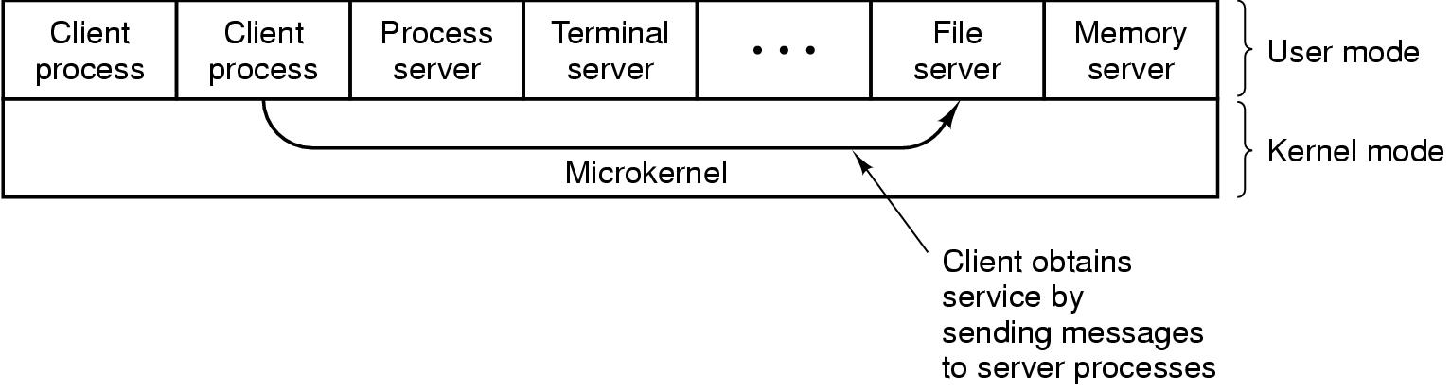
1.4 The Operating System Zoo Server operating systems

Slide 7
1.4 The Operating System Zoo Multiprocessor operating systems
Multiple CPUs
Share computer bus, clock
Advantage:
High system throughput
High availability
Multiprocessor system and Multicomputer system

Slide 8
1.4 The Operating System Zoo Personal computer operating systems
Many I/O devices
Interface to single user
Many OS (MS Windows, Mac OS, Solaris, Linux,...).

Slide 9
1.4 The Operating System Zoo Real-time operating systems
Time is a key parameter
Two types of real-time system
Hard real-time system for industrial process control system…
Soft real-time system for multimedia system

Slide 10
1.4 The Operating System Zoo Embedded operating systems
Personal digital assistant (PDA): Palm, Pocket-PC, Cellular phones), control devices
Restriction of memory size, speed of CPU,
screen size, powers
Operating System: PalmOS, Windows CE (Consumer Electronic)

Slide 11
1.4 The Operating System Zoo Smart card operating systems
CPU chips on Card
Server processing power and memory constraint
Specific Application:
Single function: electronic payments
Multiple function: proprietary systems
Java oriented: holds interpreter JVM

Slide 12
1.5 Operating System Concepts
OS Components
System calls
Operating system structure

Slide 13
1.5 Operating System Concepts
OS Components
Process Management
Main Memory Management
File management
I/O Management
Secondary Storage Management
Protection and Security

Slide 14
1.5 Operating System Concepts OS Components (1)
Process Management
Process is a Program in execution
A process needs certain resources, including CPU time, memory, files, and I/O devices, to accomplish its task.
Tasks of process management of OS:
Process creation and deletion.
process suspension and resume
Provision of mechanisms for:
- Process synchronization
- Interprocess communication
- Prevent or avoid deadlock
Notes:
Addressed in detail in Chap 2
Interprocess communication: communication between processes

Slide 15
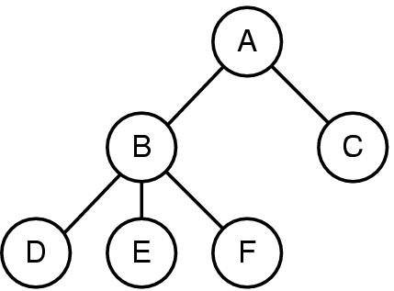
1.5 Operating System Concepts OS Components (2)
A process tree
A created two child processes, B and C
B created three child processes, D, E, and F
Notes:
If a process can create one or more other processes (referred to as child processes)
and these processes in turn can create child processes, we quickly arrive at the process tree structure

Slide 16
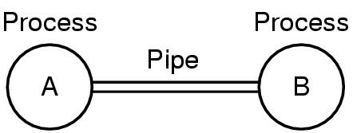
1.5 Operating System Concepts OS Components (3)
Two processes connected by a pipe
Notes:
A pipe is a sort of pseudofile that can be used to connect two processes

Slide 17
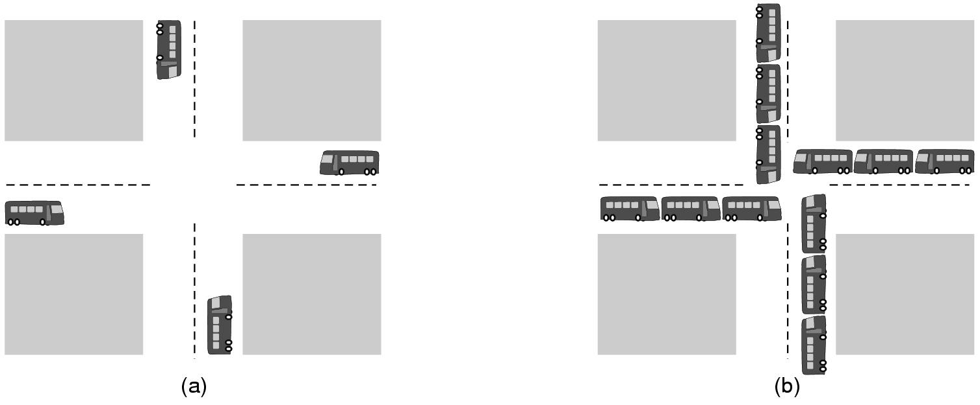
1.5 Operating System Concepts OS Components (4)
(a) A potential deadlock. (b) an actual deadlock.
Notes:
Why we have to manage the processes?
Fight with others over the priority

Slide 18
1.5 Operating System Concepts OS Components (5)
The Deadlock Problem
A set of blocked processes each holding a resource and waiting to acquire a resource held by another process in the set.
Example
System has 2 disk drives.
P₁ and P₂ each hold one disk drive and each needs another one.

Slide 19
1.5 Operating System Concepts OS Components (6)
Main Memory Management:
Motivations:
Increase system performance
Maximize memory utilization
Task of main memory of management:
Keep track of which parts of memory are currently being used and by whom.
Decide which processes to load when memory space becomes available.
Allocate and deallocate memory space as needed
Notes:
Go in to the detail in Chap 3 – you will present this chapter

Slide 20
1.5 Operating System Concepts OS Components (6)
What happens if a process has more address space than the computer has main memory and the process wants to use it all?
Main Memory Management:
Motivations:
Increase system performance
Maximize memory utilization
Task of main memory of management:
Keep track of which parts of memory are currently being used and by whom.
Decide which processes to load when memory space becomes available.
Allocate and deallocate memory space as needed
Notes:
Virtual memory: a part of the address space in main memory, a part on disk and shulttles piece back and forth between them as needed

Slide 21
1.5 Operating System Concepts OS Components (7)
File management
File system
File
Directory
Task of file management of OS:
Create and delete File/Dicrectory
Manipulate: rename, copy, move, new,…
Mapping files onto secondary storage.
File backup on stable (nonvolatile) storage media
Notes:
the concept of a directory as a way of grouping files together

Slide 22
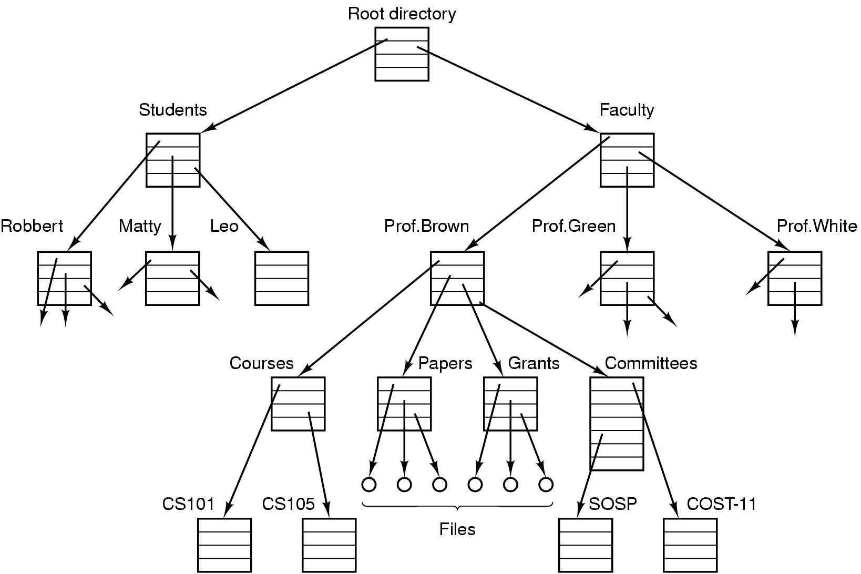
1.5 Operating System Concepts OS Components (8)
File system for a university department
Notes:
the top of the directory hierarchy, the root directory
Will come back in Chap 4

Slide 23
1.5 Operating System Concepts OS Components (9)
I/O Management
Hide the specialty of H/W devices
Task of I/O Management of OS:
Manage main memory for the devices using caching, buffering, and spooling
Maintain and provide a general device-driver interfaces
Drivers for specific hardware devices.
Notes:
All computers have physical devices for acquiring input and producing output
Spool: is an acronym for simultaneous peripheral operations on line
putting data of various I/O jobs in a buffer

Slide 24
1.5 Operating System Concepts OS Components (10)
Secondary Storage Management:
Since main memory (primary storage) is volatile and too small to accommodate all data and programs permanently, the computer system must provide secondary storage to back up main memory.
Common secondary storage devices: Magnetic disk and Optical disk
Task of Secondary Storage Management of OS:
Free space management
Storage allocation
Disk scheduling

Slide 25
1.5 Operating System Concepts OS Components (11)
Protection and Security
Protection – any mechanism for controlling access of processes or users to resources defined by the OS
Security – defense of the system against internal and external attacks
Huge range, including denial-of-service, worms, viruses, identity theft, theft of service
Notes:
Computers contain large amounts of information that users often want to protect
and keep confidential

Slide 26
1.5 Operating System Concepts OS Components (12)
Protection and Security
Systems generally first distinguish among users, to determine who can do what
User identities (user IDs, security IDs) include name and associated number, one per user
User ID then associated with all files, processes of that user to determine access control
Group identifier (group ID) allows set of users to be defined and controls managed, then also associated with each process, file
Privilege escalation allows user to change to effective ID with more rights

Slide 27
1.5 Operating System Concepts Operating System Services
One set of operating-system services provides functions that are helpful to the user:
User interface - Almost all operating systems have a user interface (UI)
Varies between Command-Line (CLI), Graphics User Interface (GUI)
Program execution - The system must be able to load a program into memory and to run that program, end execution, either normally or abnormally (indicating error)
Control access to I/O device.
File-system manipulation

Slide 28
1.5 Operating System Concepts Operating System Services
Communications – Processes may exchange information, on the same computer or between computers over a network
Error detection – OS needs to be constantly aware of possible errors
….

Slide 29
1.6 System Calls
Making System Calls
Major POSIX System Calls
Examples of System Calls

Slide 30
1.6 System Calls 2 modes to execute programs
User mode
Kernel mode
Privileged mode
Notes:
KM: directly access hardware, UM: indirectly access hardware
KM: program crash -> entire system crash -> privileged mode
US: program crash -> entire system do not crash -> safe mode

Slide 31
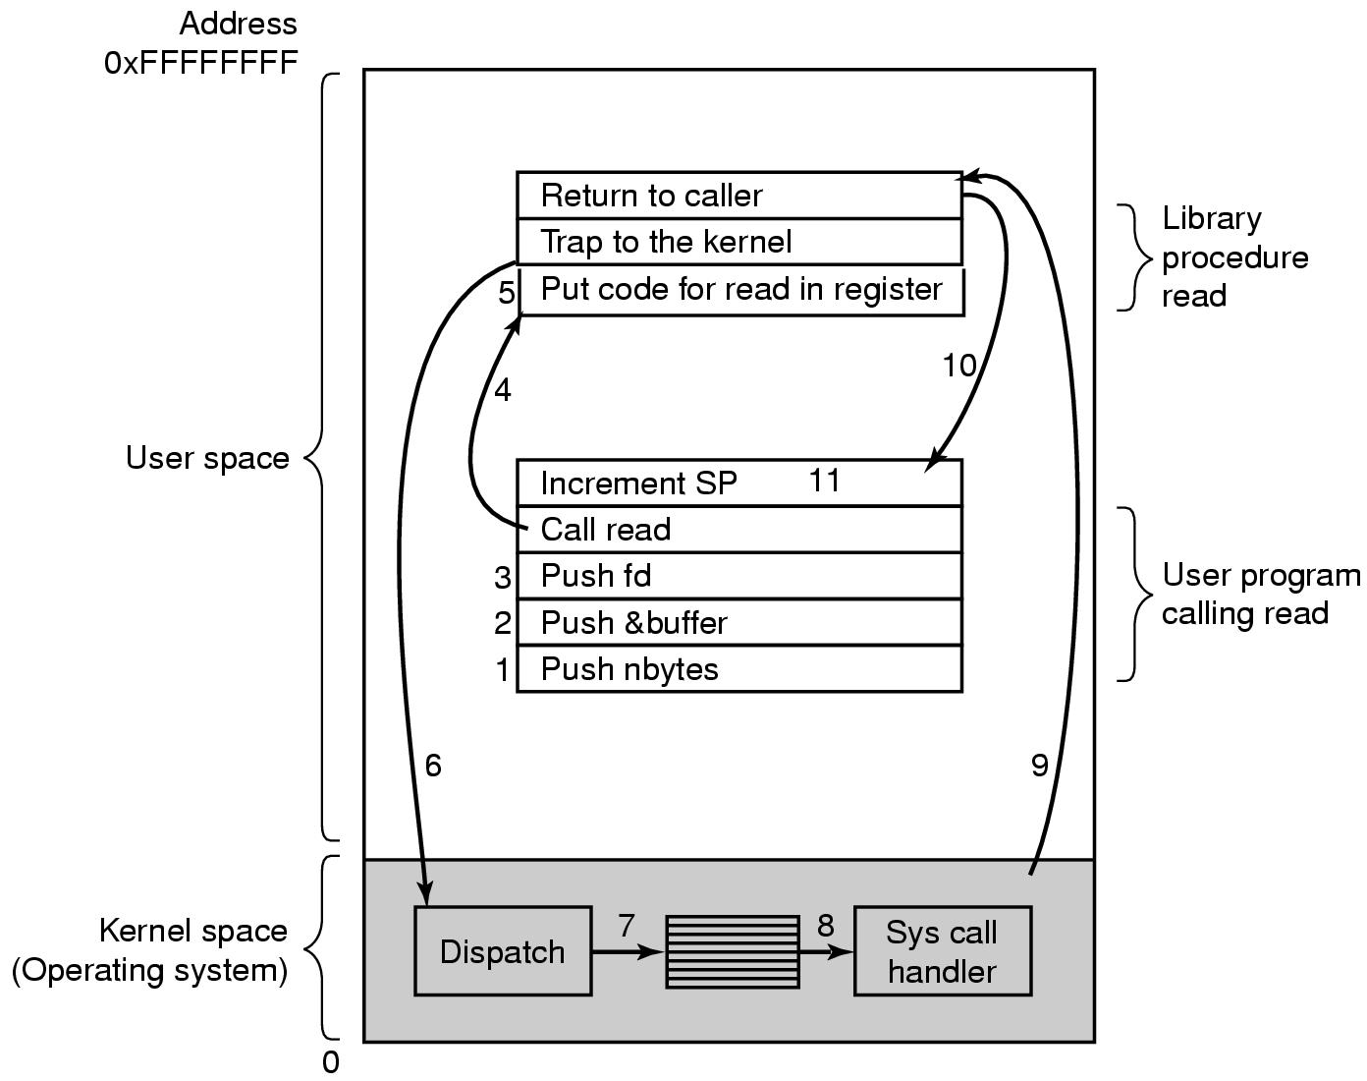
1.6 System Calls Making System Calls (1)
There are 11 steps in making the system call
read (fd, buffer, nbytes)

Slide 32
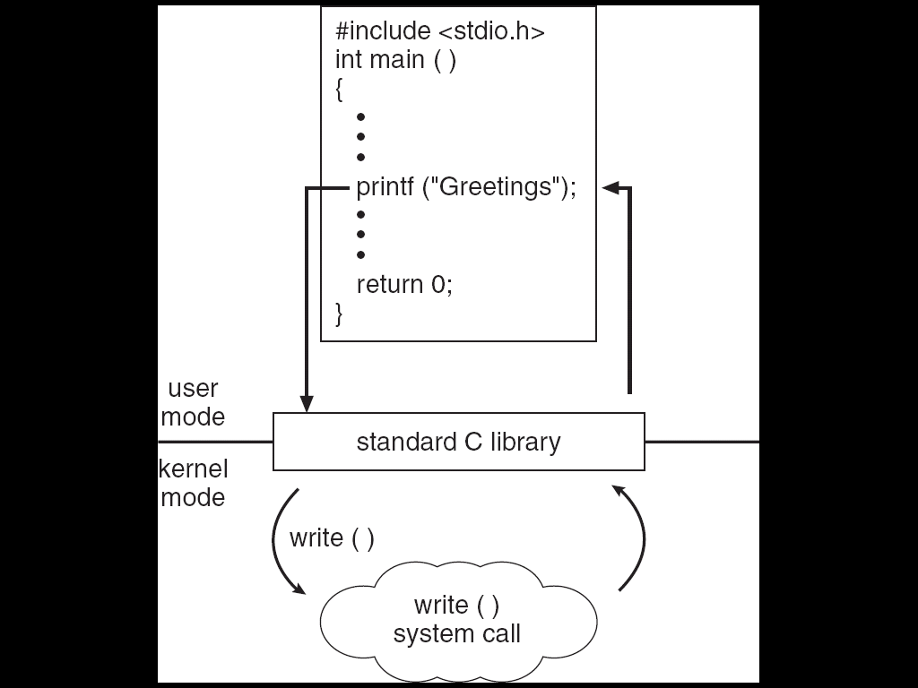
1.6 System Calls Making System Calls (2)
C program invoking printf() library call, which calls write() system call

Slide 33
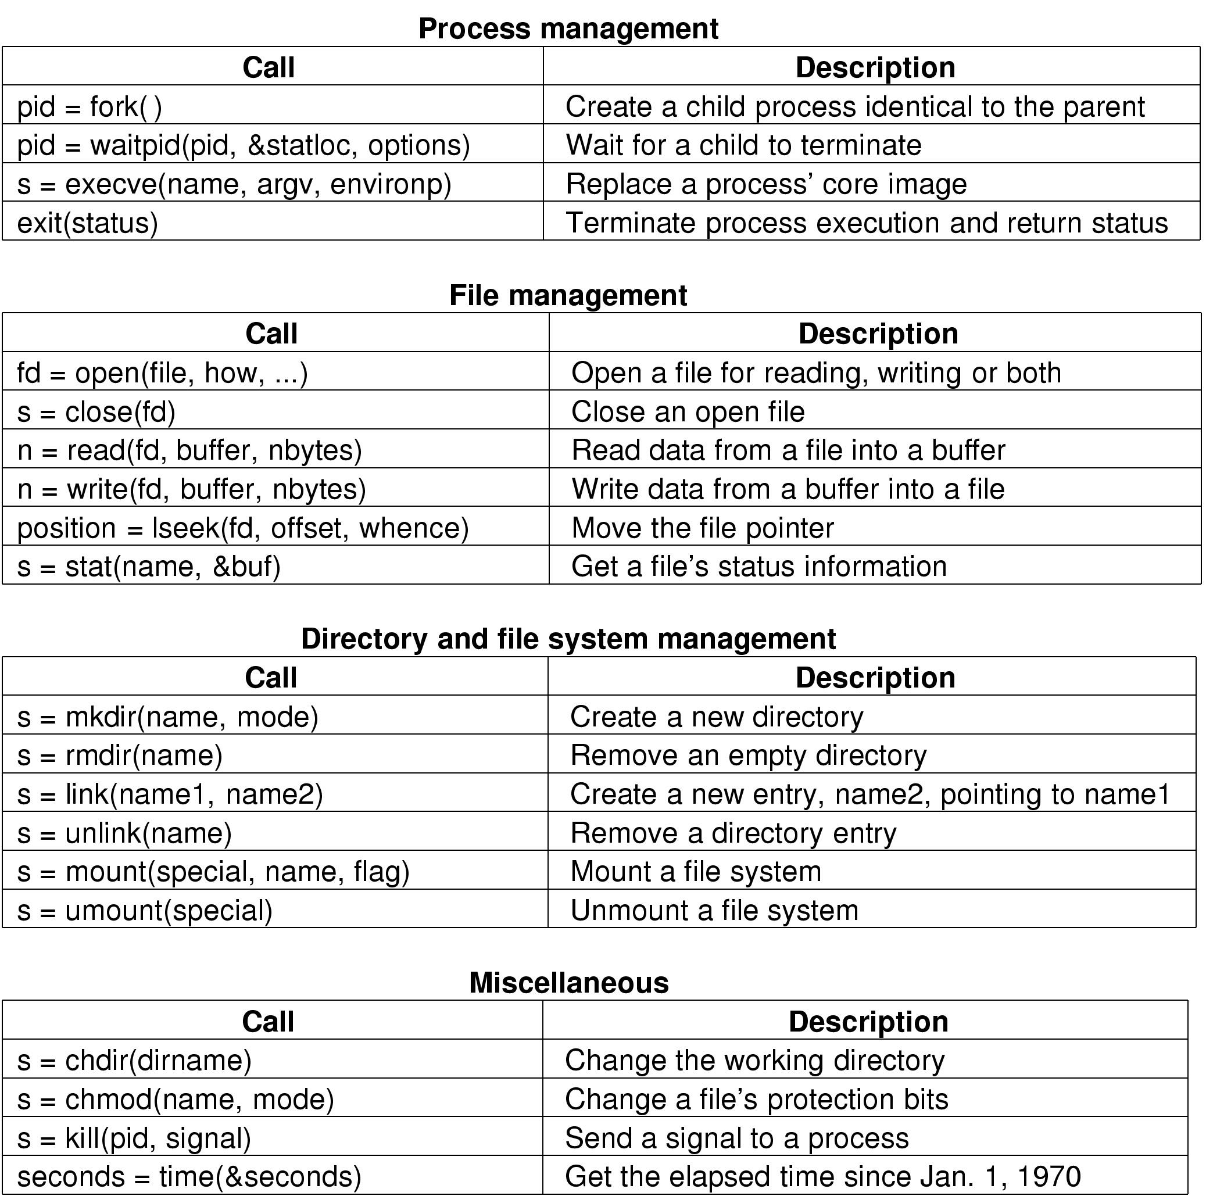
1.6 System Calls POSIX System Calls (1)
Some System Calls For Process Management
POSIX (Portable Operating System Interface)

Slide 34
1.6 System Calls POSIX System Calls (2)
Some System Calls For File Management

Slide 35
1.6 System Calls POSIX System Calls (3)
Some System Calls For Directory Management

Slide 36
1.6 System Calls POSIX System Calls (4)
Some System Calls For Miscellaneous Tasks

Slide 37
1.6 System Calls Examples (1)
A stripped down shell:
while (TRUE) { /* repeat forever */
type_prompt( ); /* display prompt */
read_command (command, parameters) /* input from terminal */
if (fork() != 0) { /* fork off child process */
/* Parent code */
waitpid( -1, &status, 0); /* wait for child to exit */
} else {
/* Child code */
execve (command, parameters, 0); /* execute command */
}
}

Slide 38
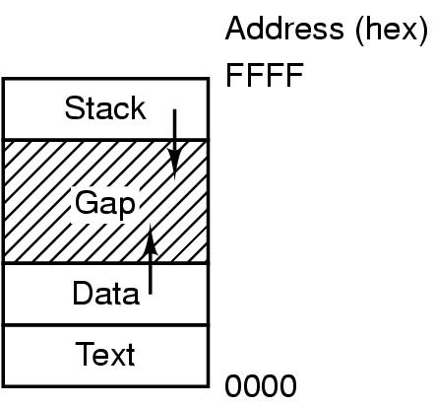
1.6 System Calls Examples (2)
Processes have three segments: text, data, stack

Slide 39
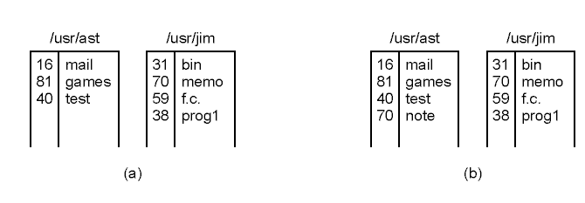
1.6 System Calls Examples (3)
(a) Two directories before linking /usr/jim/memo to ast's directory
(b) The same directories after linking
link("/usr/jim/memo", "/usr/ast/note");
Notes:
Its purpose is to allow the same file to appear under two or more names, often in different directories
the file memo in jim’s directory is now entered into ast’s directory under the name note.

Slide 40
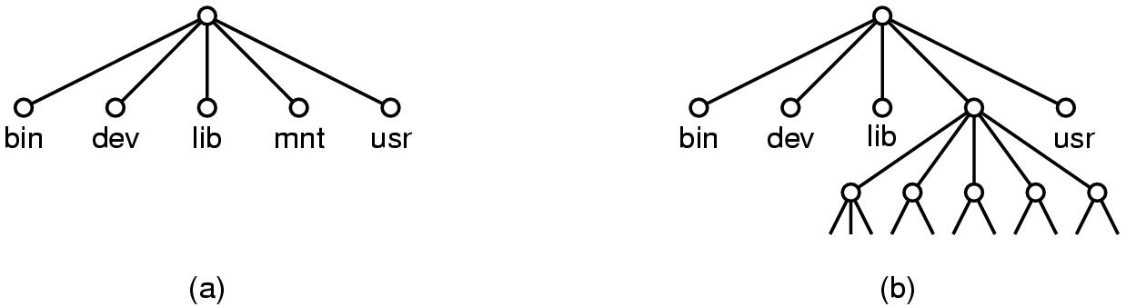
1.6 System Calls Examples (4)
(a) File system before the mount
(b) File system after the mount
mount("/dev/sdb0", "/mnt", 0);
Notes:
the user can then insert a USB disk with files to be read.
By executing the mount system call, the USB file system can be attached to the root file system

Slide 41
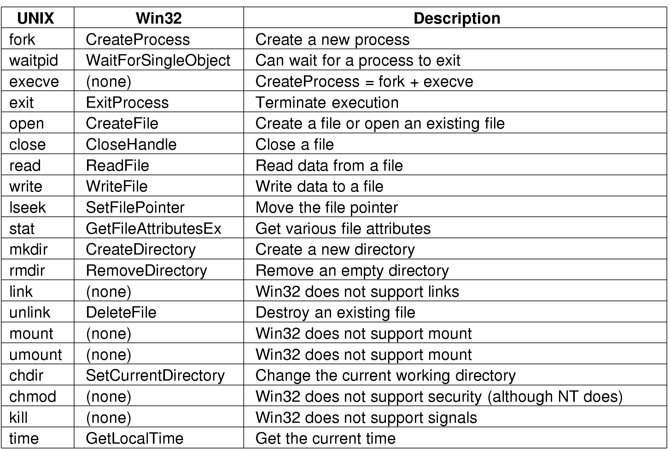
1.6 System Calls
Some Win32 API calls

Slide 42
1.7 Operating System Structure
Monolithic system
Layered System
Virtual Machine
Client-server model
Microkernel
Notes:
Structure or Architecture?

Slide 43
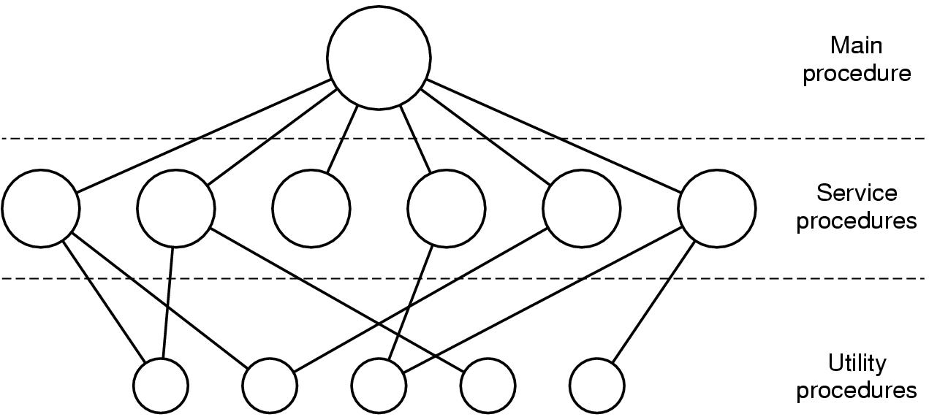
1.7 Operating System Structure Monolithic system (1)
Simple structuring model for a monolithic system
Notes:
in the monolithic approach the entire operating system runs as a single program in kernel mode
Even in monolithic systems, however, it is possible to have some structure

Slide 44
1.7 Operating System Structure Monolithic system (2)
Structure of Operating System:
A main program that invokes the requested service procedure.
A set of service procedures that carry out the system calls.
A set of utility procedures that help the service procedures.

Slide 45
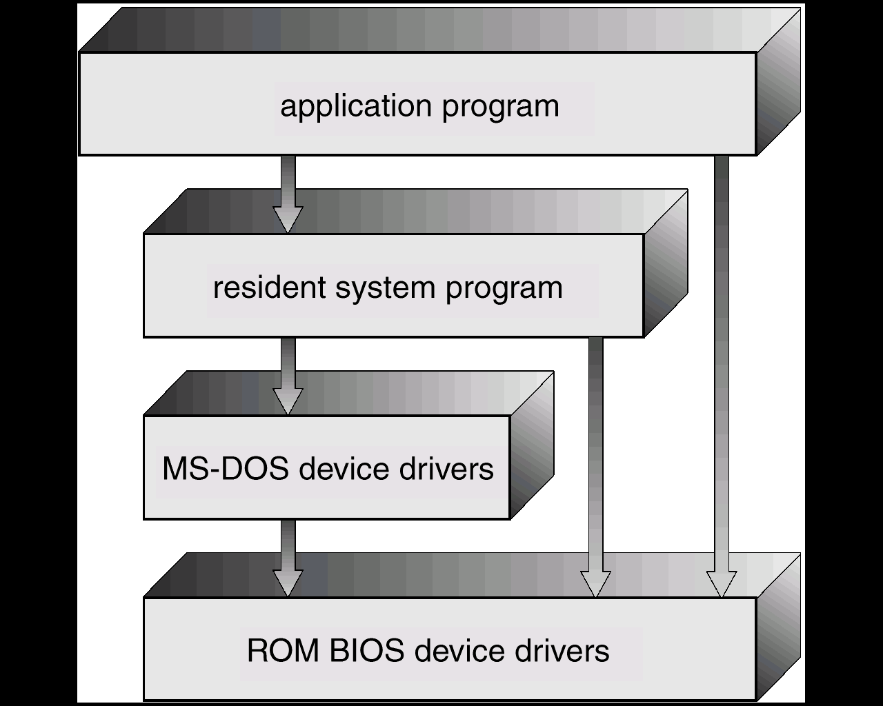
1.7 Operating System Structure Monolithic system (3) : Example
Monolithic
MS-DOS – written to provide the most functionality in the least space:
not divided into modules;
Although MS-DOS has some structure, its interfaces and levels of functionality are not well separated
Notes:
Advantage: single large program -> call functions very efficiently
Disadvantage: difficult to understand, crash in any procedures will take down entire system

Slide 46
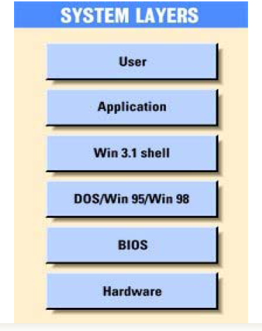
1.7 Operating System Structure Layered System (1): Example

Slide 47
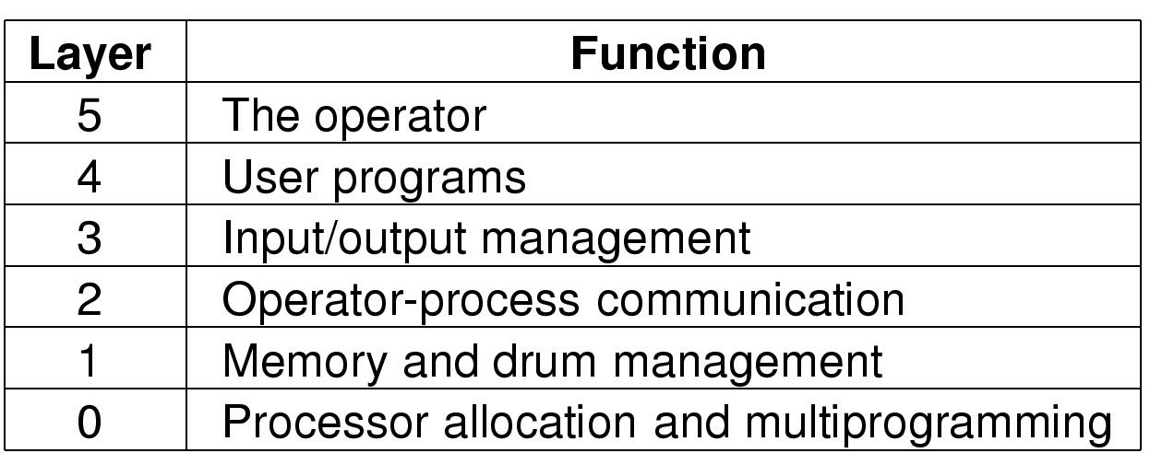
1.7 Operating System Structure Layered System (2): Example
Structure of the THE operating system

Slide 48
1.7 Operating System Structure Layered System (3)
Many Layers
Each layer has well defined functions
Upper layer can only calls functions of closely lower layer
Advantages:
Easier to extend
Easier to debug from lower to upper layer
Disadvantage?

Slide 49
1.7 Operating System Structure Virtual Machine (1)
processes
kernel
hardware
processes | processes | processes
kernel | kernel | kernel
VM1 | VM2 | VM3
Virtual-machine implementation
hardware
programming
interface
Non-virtual machine system model
Virtual machine system model

Slide 50
1.7 Operating System Structure Virtual Machine (2)
A virtual machine takes the layered approach to its logical conclusion. It treats hardware and the operating system kernel as though they were all hardware
A virtual machine provides an interface identical to the underlying bare hardware
The operating system creates the illusion of multiple processes, each executing on its own processor with its own (virtual) memory

Slide 51
1.7 Operating System Structure Virtual Machine (3)
The resources of the physical computer are shared to create the virtual machines
CPU scheduling can create the appearance that users have their own processor
Spooling and a file system can provide virtual card readers and virtual line printers
A normal user time-sharing terminal serves as the virtual machine operator’s console

Slide 52
1.7 Operating System Structure Client-server model (1)
The client-server model
Notes:
Often the lowest layer is a microkernel, but that is not required The essence is the presence of client processes and server processes.

Slide 53
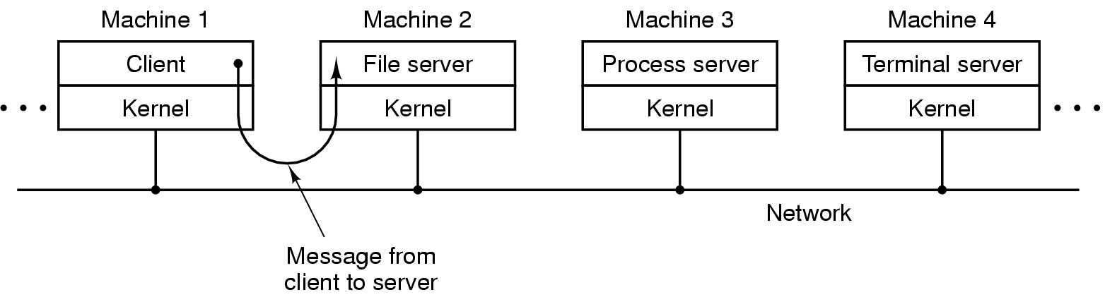
1.7 Operating System Structure Client-server model (2)
The client-server model in a distributed system

Slide 54
1.7 Operating System Structure Microkernel: Example
Microkernel
OS design: The operating system is divided into microkernel (CMU Mach OS - 1980)
Moves as much from the kernel into “user” space
kernel → microkernel
Communication takes place between user modules using message passing.
Application
POSIX
application
X-application
File
server
POSIX
server
X-window
server
Notes:
Disadvantage: overhead

Slide 55
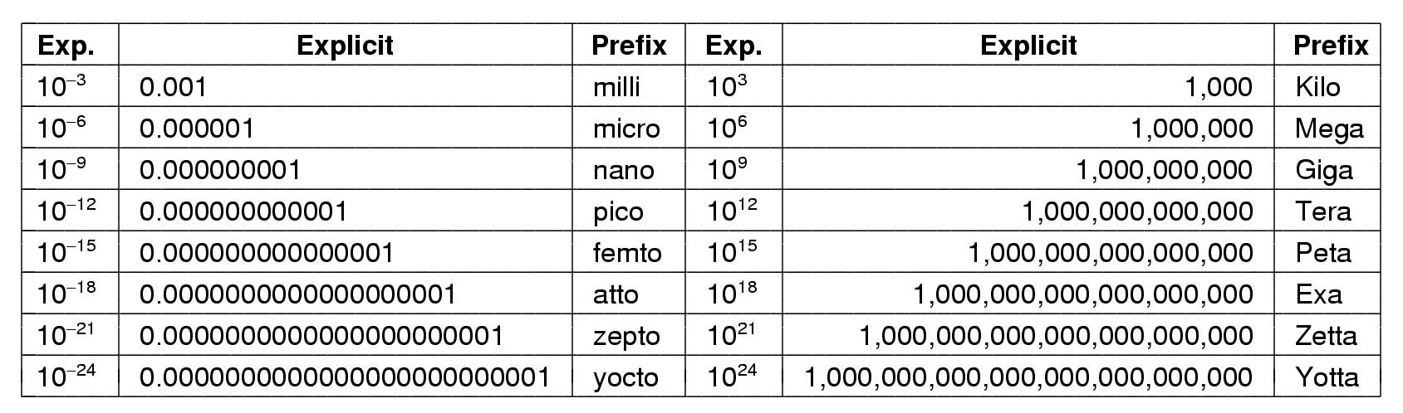
Metric Units
The metric prefixes

